Slide 1


Body Mass Index calculator
Looking at
Whats is BMI?
Using ML and BMI data?
P.A.R.D ABSWER
P.A.R.D EXPLANATION
PROBLEM
ACTION
RESULT
DEVELOPEMNT
Presenter: Mattithyahu Owolabi

Slide 2
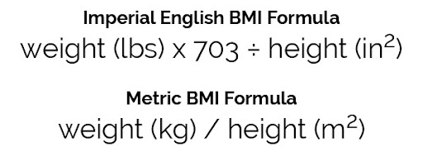

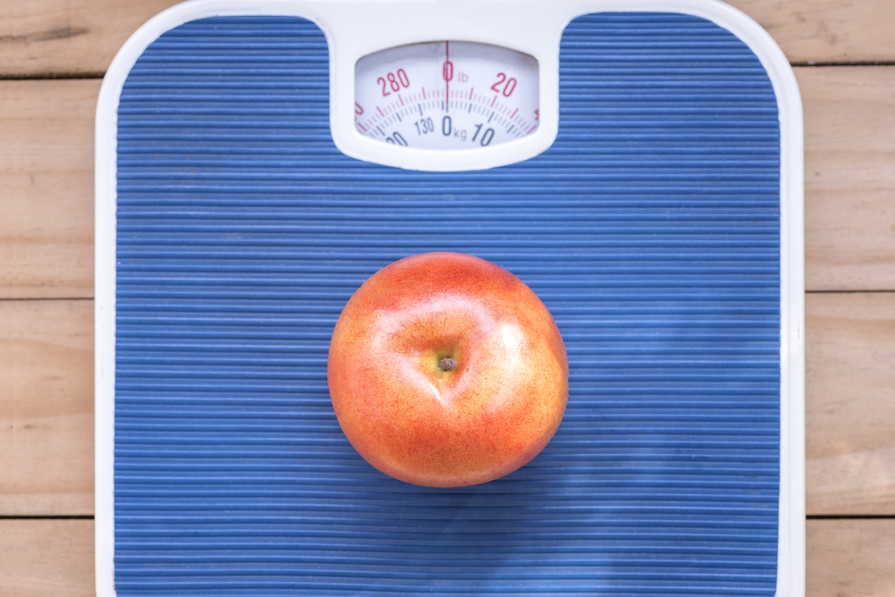
Project Overview
What is BMI?
Index classification equation used to give insight on an individuals obesity.
BMI is not used to diagnose obesity because people who are very muscular can have a high BMI without much fat.
But for most people, BMI is a useful indication of whether they're a healthy weight.
It's a common problem in the UK that's estimated to affect around 1 in every 4 adults and around 1 in every 5 children aged 10 to 11. – Source NHS England (SEE HOW THEY SOURCE IN TEXT) EXAMPLES…
The majority of adults were overweight or obese; 67% of men and 60% of women.
How to tell if you're obese
The most widely used method to check if you're a healthy weight is body mass index (BMI).
List the questions they are looking to answer by attending your presentation
Avoid technical jargon or code if your audience won’t understand it

Slide 3
Project Overview
What is BMI?
How to use this data and Machine learning?
BMI is not used to diagnose obesity because people who are very muscular can have a high BMI without much fat.
But for most people, BMI is a useful indication of whether they're a healthy weight.
It's a common problem in the UK that's estimated to affect around 1 in every 4 adults and around 1 in every 5 children aged 10 to 11. – Source NHS England (SEE HOW THEY SOURCE IN TEXT) EXAMPLES…
How to tell if you're obese
The most widely used method to check if you're a healthy weight is body mass index (BMI).
The first slide, after the title, should explain the problem statement. Why are you working on this project? What is the benefit? This gives an introduction and should convey the importance of the project. It is probably best to use two slides, one for the problem, and another for the benefits of the analytics.
Next up is methodology. Talk about how you broke the problem down and what tools you used. Explain any challenges you overcame. This is a good time to show how thorough of a job you did. No need to get too detailed though, unless you are presenting to a technical audience.
After methodology, talk about your findings. What new things did you discover? Were you able to support existing theories about the business using statistics? How did your machine learning model perform? This is the most important part of the presentation, as it is the results of your project.

Slide 4
What is BMI? METHODOLOGY
What is BMI?
How to use this data and Machine learning?
BMI is not used to diagnose obesity because people who are very muscular can have a high BMI without much fat.
But for most people, BMI is a useful indication of whether they're a healthy weight.
It's a common problem in the UK that's estimated to affect around 1 in every 4 adults and around 1 in every 5 children aged 10 to 11. – Source NHS England (SEE HOW THEY SOURCE IN TEXT) EXAMPLES…
How to tell if you're obese
The most widely used method to check if you're a healthy weight is body mass index (BMI).
Next up is methodology. Talk about how you broke the problem down and what tools you used. Explain any challenges you overcame. This is a good time to show how thorough of a job you did. No need to get too detailed though, unless you are presenting to a technical audience.
After methodology, talk about your findings. What new things did you discover? Were you able to support existing theories about the business using statistics? How did your machine learning model perform? This is the most important part of the presentation, as it is the results of your project.

Slide 5
What is BMI?
What is BMI?
How to use this data and Machine learning?
BMI is not used to diagnose obesity because people who are very muscular can have a high BMI without much fat.
But for most people, BMI is a useful indication of whether they're a healthy weight.
It's a common problem in the UK that's estimated to affect around 1 in every 4 adults and around 1 in every 5 children aged 10 to 11. – Source NHS England (SEE HOW THEY SOURCE IN TEXT) EXAMPLES…
How to tell if you're obese
The most widely used method to check if you're a healthy weight is body mass index (BMI).
Now that the findings have been discussed, make some recommendations. This helps put the analytics to work in the real world. You may not be the one making big business decisions, but your analytics could be what is driving them. Domain knowledge and knowledge of business operations is a real force multiplier here.
Finally and optionally, talk about future work. What are the next steps? Does the problem need to be revisited in the future? Can the project be improved with more work? If you were given more time and resources, is there anything that could be done better?
These talking points should help you organize your presentations. It is popular to talk about statistical methods and machine learning algorithms on the internet, but keep in mind that communication skills are just as important.

Slide 6
Conclusion
What is BMI?
How to use this data and Machine learning?
BMI is not used to diagnose obesity because people who are very muscular can have a high BMI without much fat.
But for most people, BMI is a useful indication of whether they're a healthy weight.
It's a common problem in the UK that's estimated to affect around 1 in every 4 adults and around 1 in every 5 children aged 10 to 11. – Source NHS England (SEE HOW THEY SOURCE IN TEXT) EXAMPLES…
How to tell if you're obese
The most widely used method to check if you're a healthy weight is body mass index (BMI).
Now that the findings have been discussed, make some recommendations. This helps put the analytics to work in the real world. You may not be the one making big business decisions, but your analytics could be what is driving them. Domain knowledge and knowledge of business operations is a real force multiplier here.
Finally and optionally, talk about future work. What are the next steps? Does the problem need to be revisited in the future? Can the project be improved with more work? If you were given more time and resources, is there anything that could be done better?
These talking points should help you organize your presentations. It is popular to talk about statistical methods and machine learning algorithms on the internet, but keep in mind that communication skills are just as important.
Reiterate important takeaways at the end of your presentation

